Slide 1

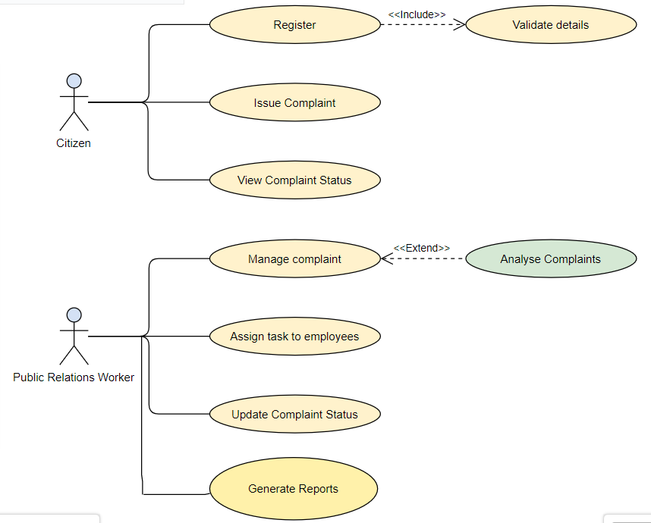
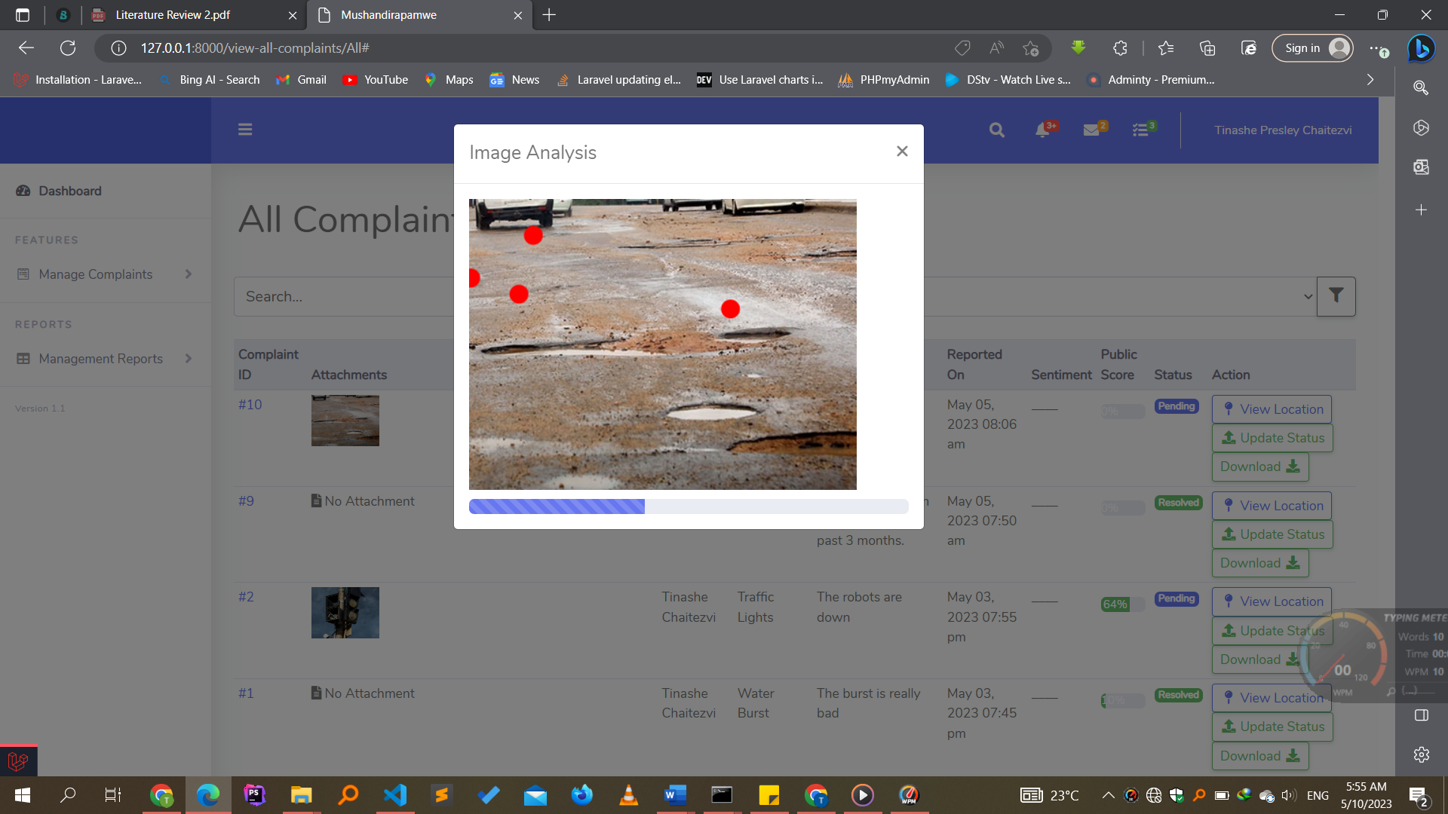
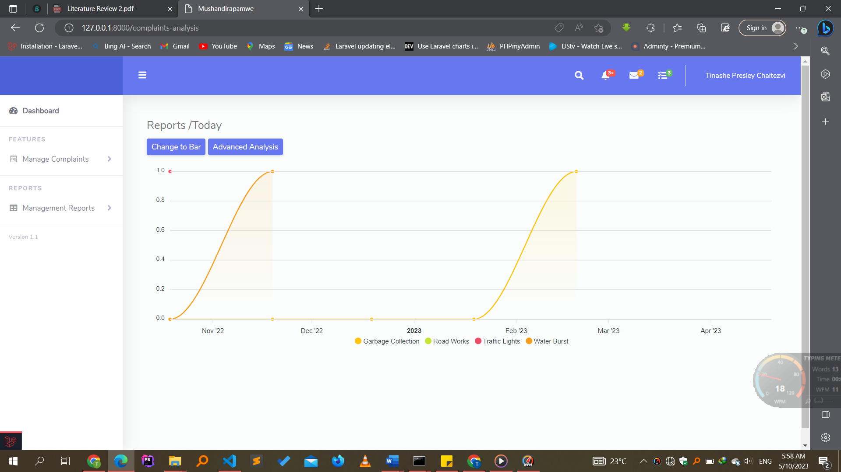
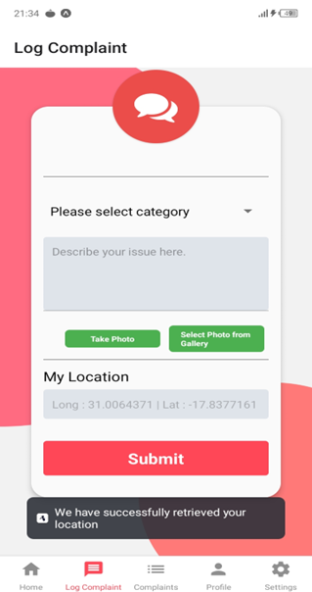
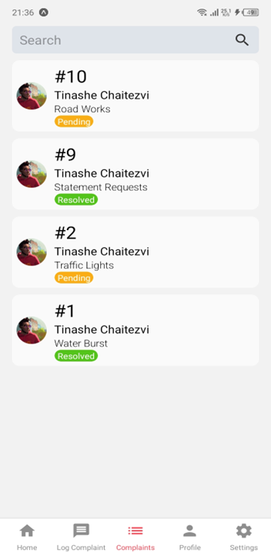
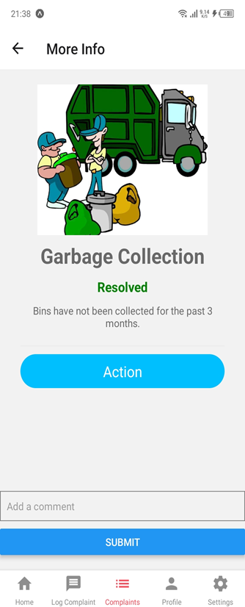
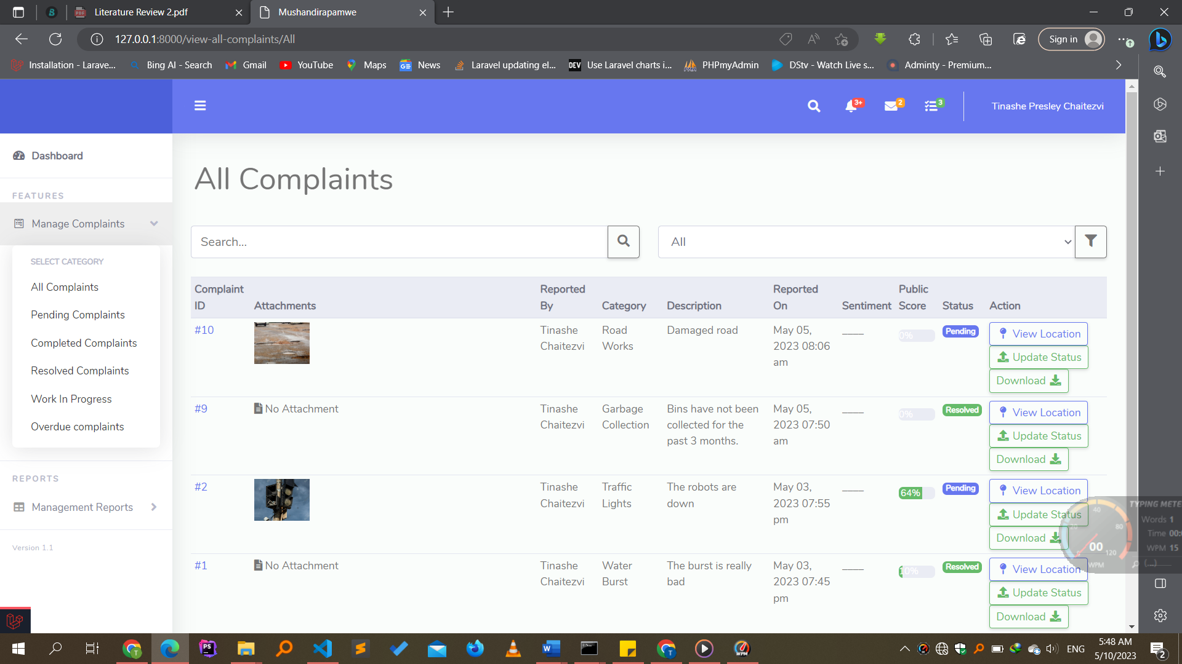
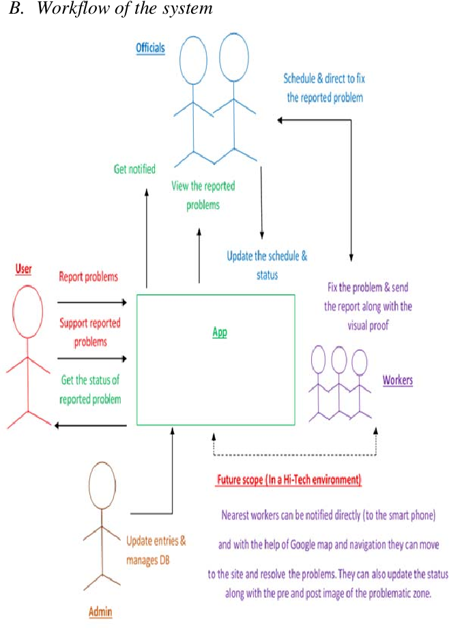
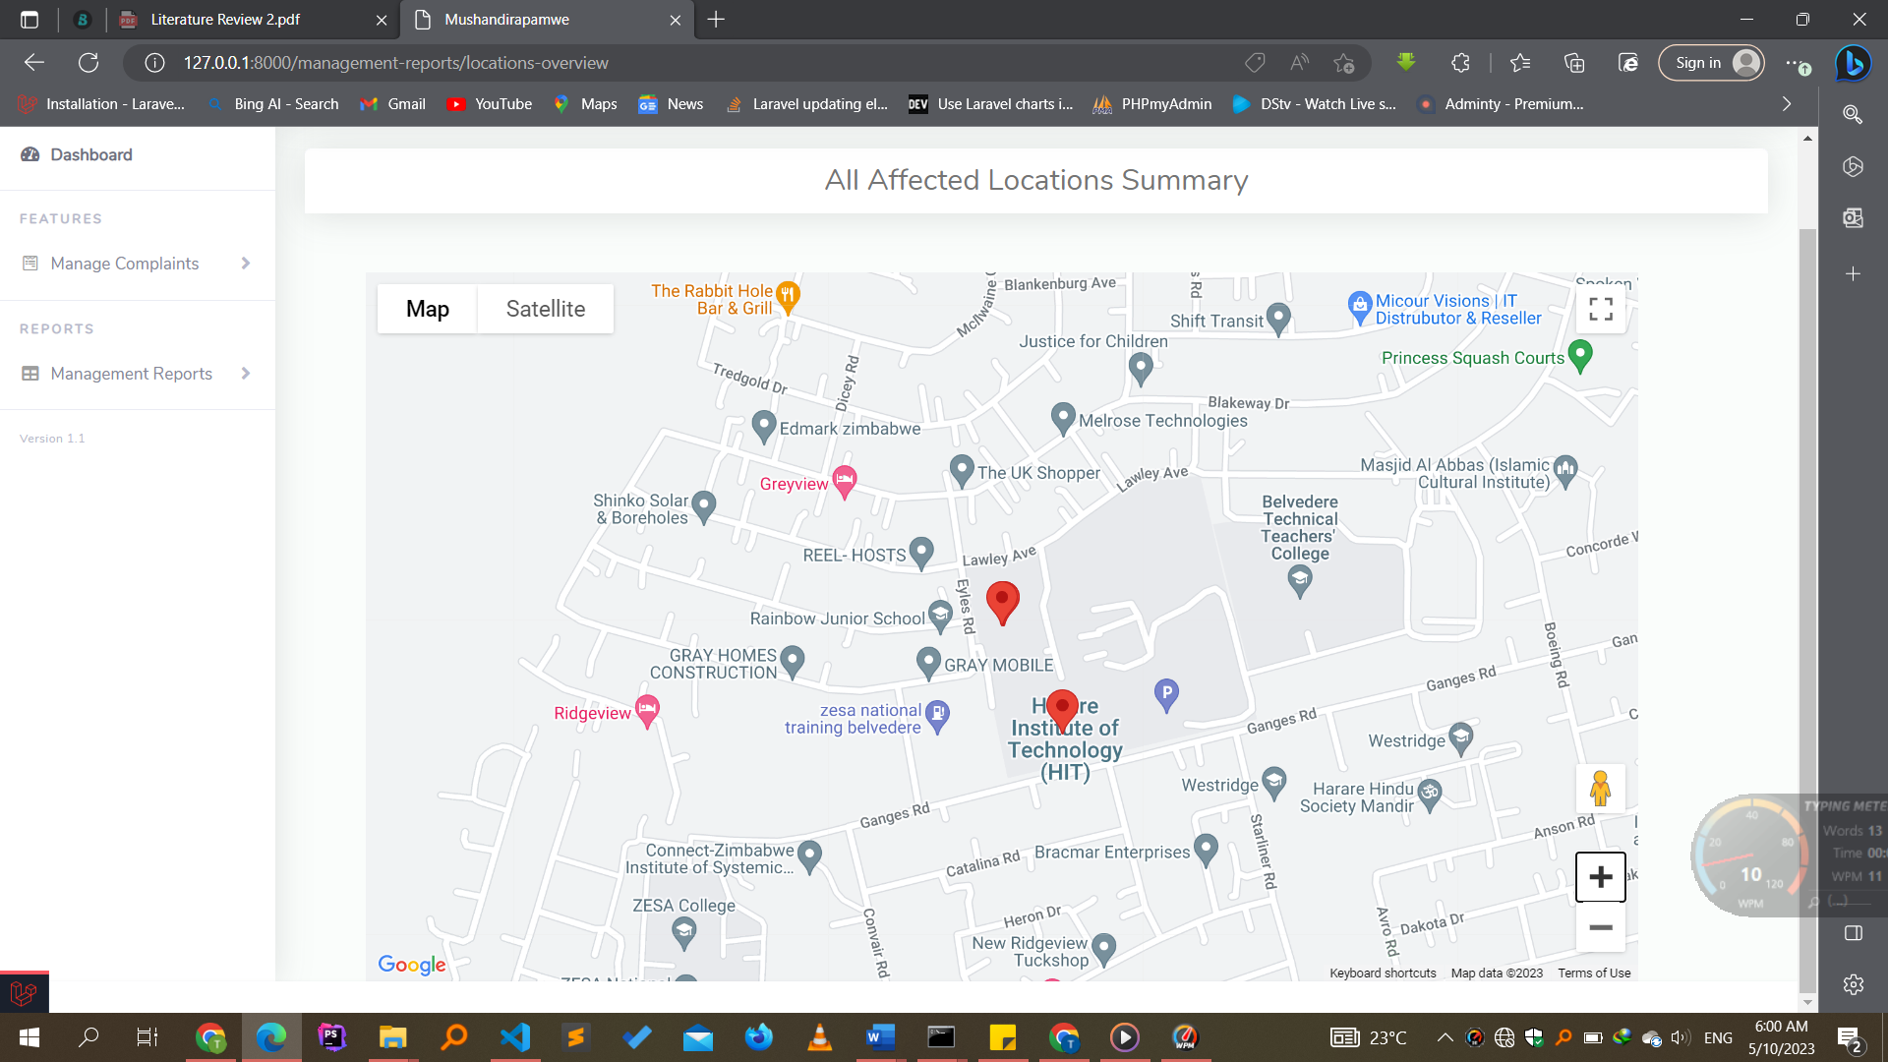
SMART CIVIC ISSUES REPORTING SYSTEM
Tinashe Presley Chaitezvi - Software Engineering Department
1.0 Abstract
3.0. Problem definition
7.0. Use Case Diagram
Reporting infrastructure issues in cities is a time-consuming and often frustrating process for citizens. This is due to the lengthy steps and procedures involved in reporting problems, as well as the lack of guarantee that complaints will be processed in a timely manner. As a result, many complaints go unheard, unanswered, and unresolved.
To address this issue, we propose a novel mobile application that allows citizens to report infrastructure issues to relevant authorities in a quick and easy manner. The application uses a hybrid CNN-RNN image processing algorithm to detect the severity of reported problems, so that higher-severity issues can be addressed first. The application also uses the GPS sensor on smart mobile devices to pinpoint the exact location of the problem zone and use the camera to record the problem area as visual evidence. The system then generates a form containing all the data and location and visual evidence entered by the user and sends it to a central server. The central server then notifies the relevant agencies, who are able to take action to resolve the issue.
We believe that this mobile application will make it easier for citizens to report infrastructure issues and will help to improve the quality of life in cities
Citizens frequently express dissatisfaction with the state of their surrounding urban infrastructure. However, they often hesitate to utilize conventional grievance systems due to their cumbersome and time-consuming procedures, such as physically visiting government offices and enduring long waiting times. As a result, a communication gap arises between citizens and government agencies, hindering the identification and resolution of issues. Furthermore, the inefficiency of traditional grievance systems contributes to delays in problem resolution. This calls for a more streamlined and accessible approach to enable efficient communication and prompt action, empowering citizens to voice their concerns and ensuring a more responsive and accountable urban governance system.
4.0. Overview of the developed application
The developed application is a mobile and web-based platform aimed at addressing the civic issues faced by citizens and improving the communication between citizens and government agencies. The application allows users to easily report complaints related to infrastructure problems and participate in the decision-making process. With automatic geo-tagging, reported complaints are accurately located on a map for efficient management by civil servants. The system also incorporates image processing techniques to classify feedback and assess the severity of reported issues. Furthermore, the application generates data-driven analysis reports, providing intelligent insights to aid decision-making processes. Overall, the application promotes transparency, accessibility, and efficiency in managing civic complaints and resolving issues.
8.0. Screenshots
2.0. Introduction
Today's smartphones have the potential to revolutionize the way we engage with our communities. By harnessing the power of crowdsourcing, we can empower citizens to solve complex problems and improve our cities in ways that were never before possible.
One of the most important ways that crowdsourcing can be used to improve our cities is through citizen complaints. Complaints are a valuable source of feedback that can help us identify and address problems that we might not otherwise know about. However, traditional grievance systems can be time-consuming and inconvenient for citizens.
To address this challenge, we have developed an Android application that makes it easy for citizens to report complaints with just two clicks. The application is easy to use and does not require any background knowledge of the complaint process. This makes it accessible to everyone, regardless of their age or technical expertise.
In addition to making, it easier for citizens to report complaints, our application also provides a transparent and efficient way for civil servants to address them. Once a complaint is submitted, it is immediately routed to the appropriate department for review. Our application is just one example of how crowdsourcing can be used to improve our cities. By empowering citizens to participate in the decision-making process, we can create more vibrant and equitable communities for everyone.
Conclusion
In conclusion, the developed application, Mushandirapa, addresses the pressing need for an efficient and transparent grievance system between citizens and municipal corporations. The application offers a user-friendly mobile platform for citizens to report complaints and participate in the decision-making process. By automatically geo-tagging the reported complaints, the application ensures accurate location information. The web portal enables officials to manage and update the resolution status of complaints, improving communication and accountability. The integration of map markers allows for visual representation of the reported issues, aiding in efficient problem identification.
5.0. Objectives
To automatically .geo-tag the reported complaints using a mobile application
To manage civic complaints and update resolution via web application
To highlight the reported issues on a map using map markers
To classify feedback from citizens to gain an overview of the damage severity and generate data-driven analytics
Supervisor: Mr Makondo
6.0. System Overview

